Slide 1
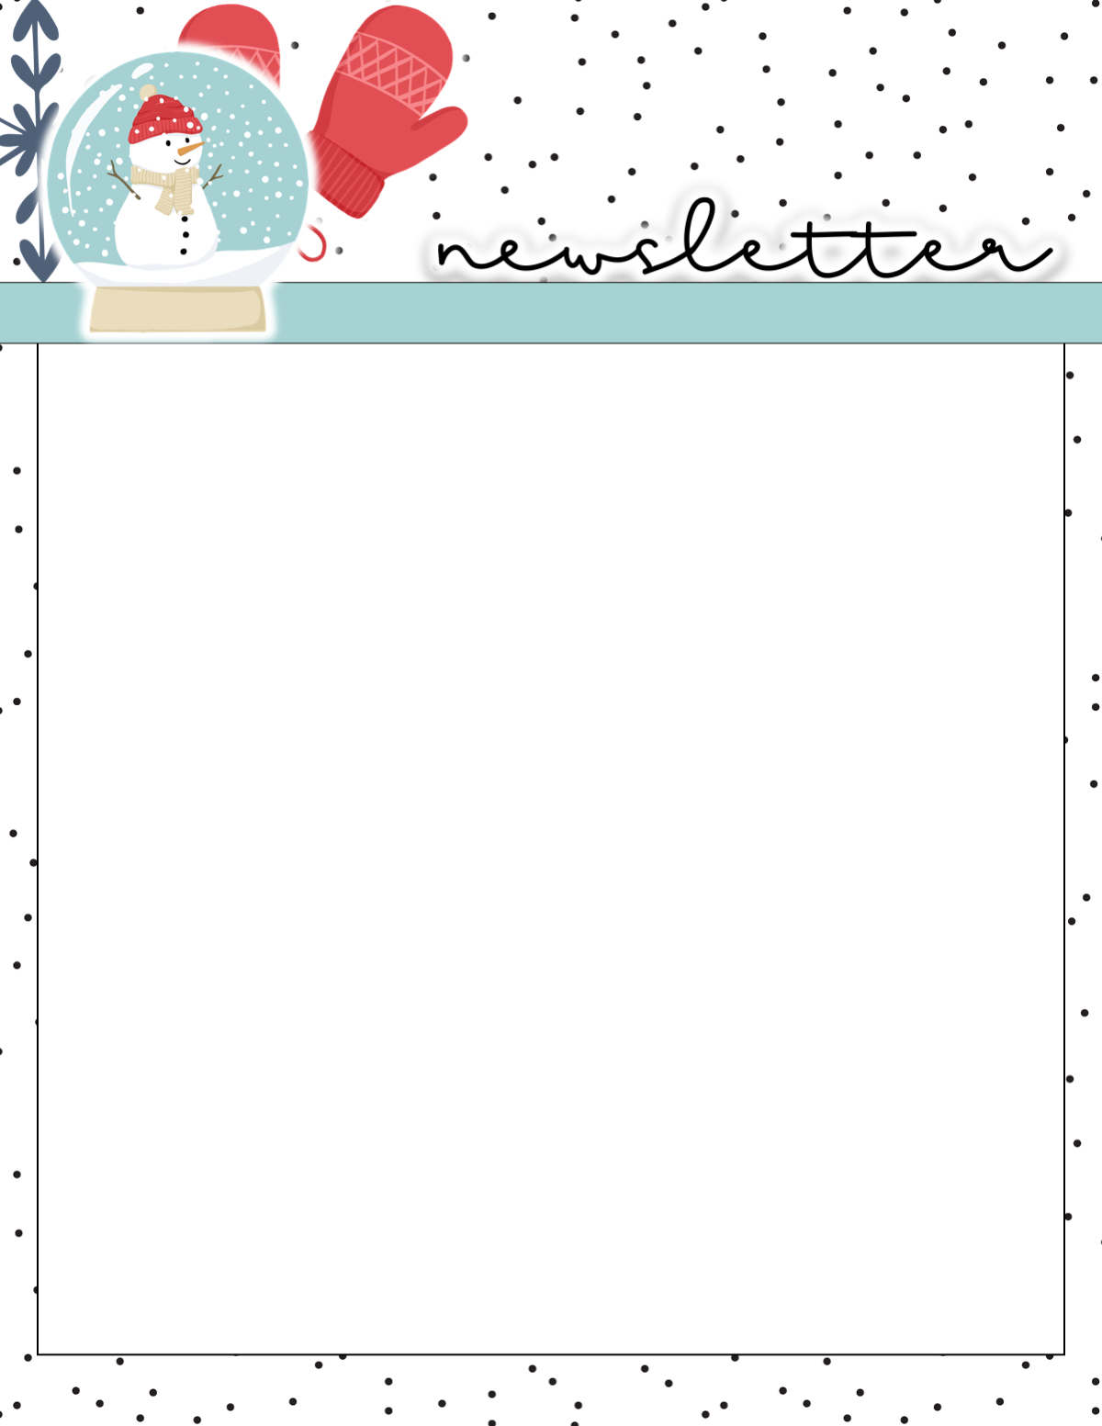
Mrs. Peacock’s
December 4-8, 2023
Weekly Skills
Coming up @ NSE
ELA: Christmas Around the World
PHONICS: r- controlled vowel: ar
LANGUAGE: Friendly Letter
MATH: Understand 3-digit numbers
S. STUDIES: Continents & Oceans
Dec. 5-7: CASE testing
Dec. 15: Pajama Day
Dec. 18: Wear Red Day
Dec. 19: Wear Green Day
Dec. 20: Grinch Day
Phonics Skill OF THE WEEK
r- controlled vowel: ar
car
chart
spark
yard
star
far
park
farm
barn
marsh
good
our
now
warm
people
only
your
use
dark
marks
Reminders-
Send water & snack everyday
Check your child’s folder daily.
Signed papers go home on Tues.
Return kindness lightbulb by Wed.
Please send Coins for Christmas!
Homework/Tests-
Homework- Math, Reading, and math facts each night
Spelling and Fact tests- Friday

